Slide 1
Diaphragmatic hernia
Acquired type ( post traumatic)

Slide 2
The diaphragm is a dome-shaped muscular barrier between the chest and abdominal cavities. It separates the heart and lungs from your abdominal organs (stomach, intestines, spleen, and liver).
It is either congenital or acquired

Slide 3
acquired diaphragmatic hernia risk factors
blunt injuries due to a traffic accident
surgical procedures on the chest or abdomen
falls that impact the diaphragm region
stab wounds
gunshot wounds

Slide 4
SIGNS AND SYMPTOMS
Respiratory distress (tachypnea, grunting, cyanosis, use of accessory muscles – cardinal sign • Scaphoid abdomen • Increased chest wall diameter • Bowel sound heard in chest with decreased/absent breath sounds on side of hernia • Shifting of apex beat contralateral side of hernia

Slide 5
DELAYED PRESENTATION
Often right side • Regurgitation • Vomiting(intestinal obstruction) • Incarceration of intestine • ischemia sepsis and shock

Slide 6
DIAGNOSIS
Chest X Ray with nasogastric tube
Barium study
Echocardiography

Slide 7
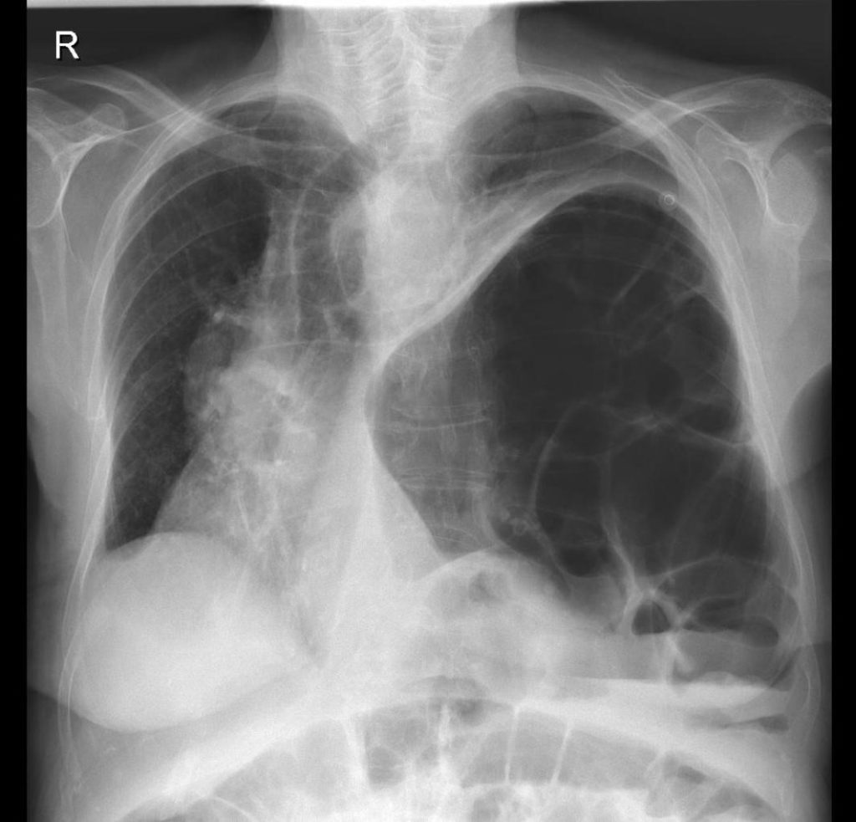

Slide 8
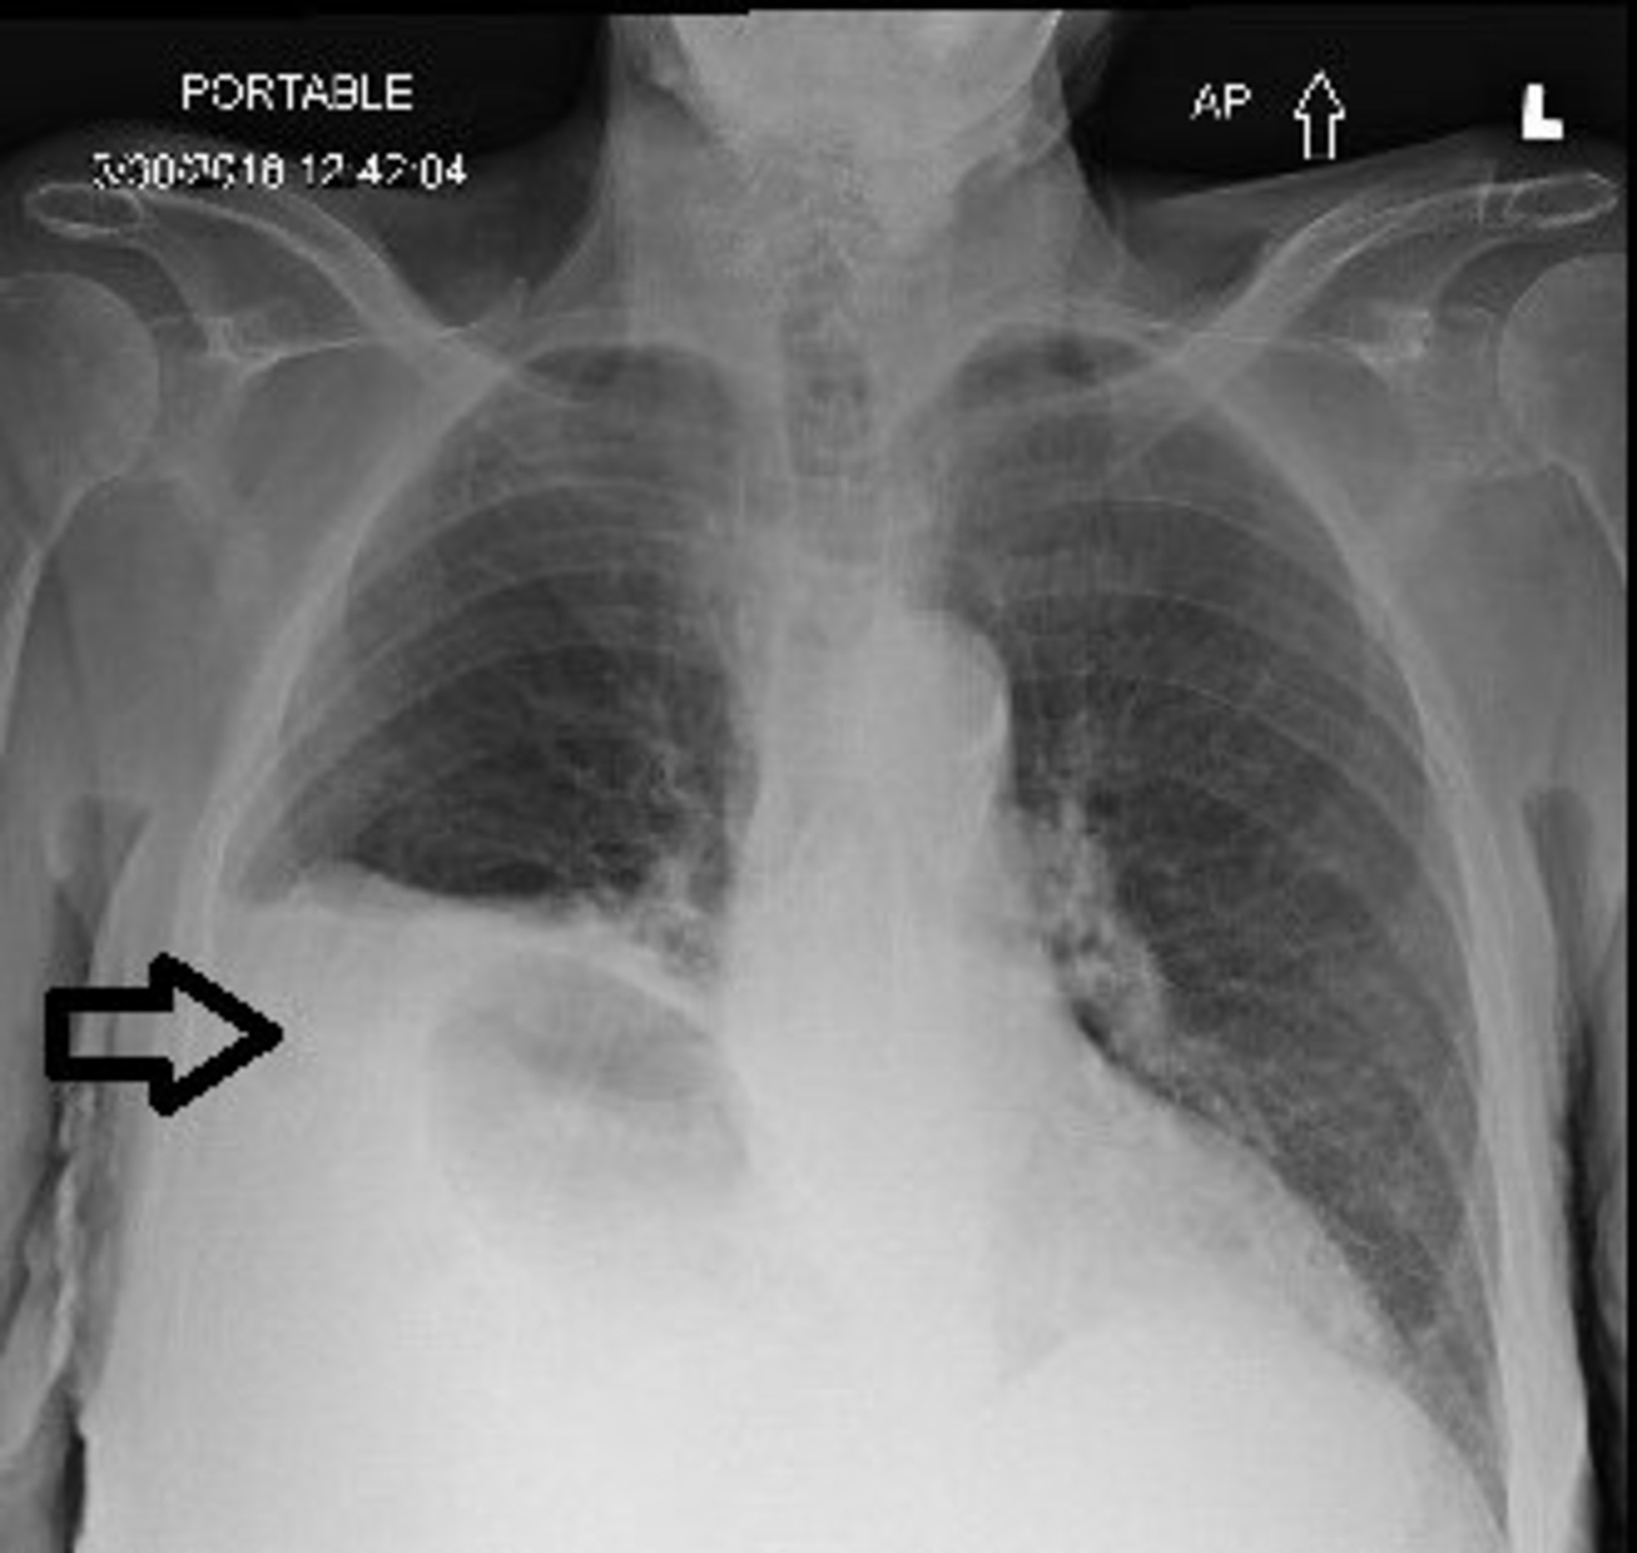

Slide 9
Management
Surgical repair:
Mostly after 48 hrs after stabilization and resolution of pulmonary hypertension •
Most common approach : subcostal approach • Laparoscopic and thoracoscopic repair : Native tissue vs mesh repair ( prolene , GORETEX, porous polytetrafluroethylene patch)

Slide 10
Complications
GERD (50%)
• Intestinal Obstruction (20%)
• Recurrent diaphragmatic hernia (5-20%)

Slide 11
Disease of peritoneum

Slide 12
Objectives
1)defines functions of normal peritoneum.
Peritonitis.
Intra-abdominal abscess.
ascitis

Slide 13
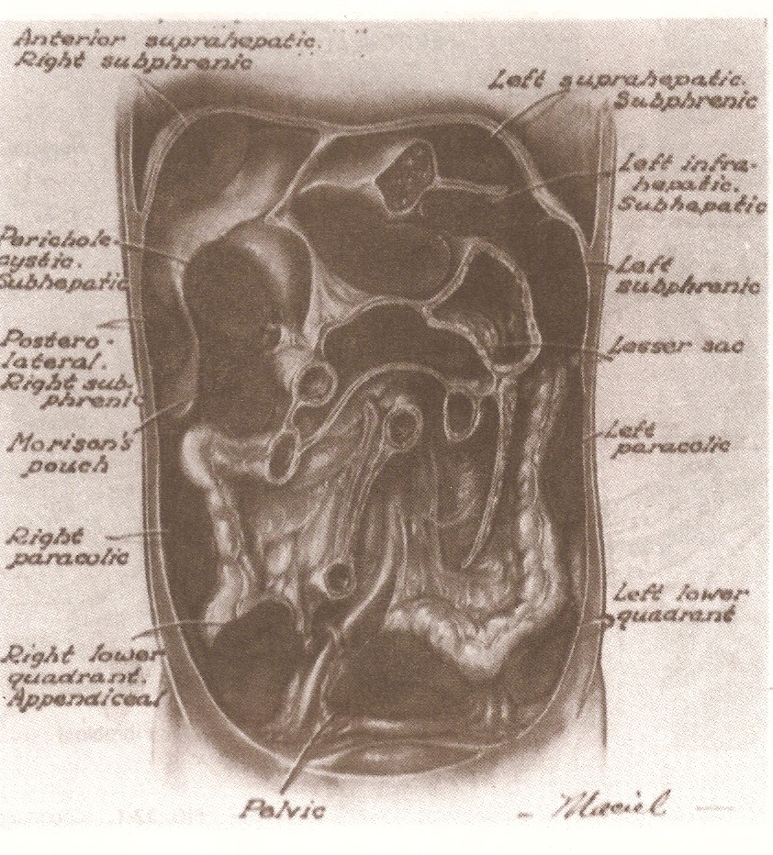
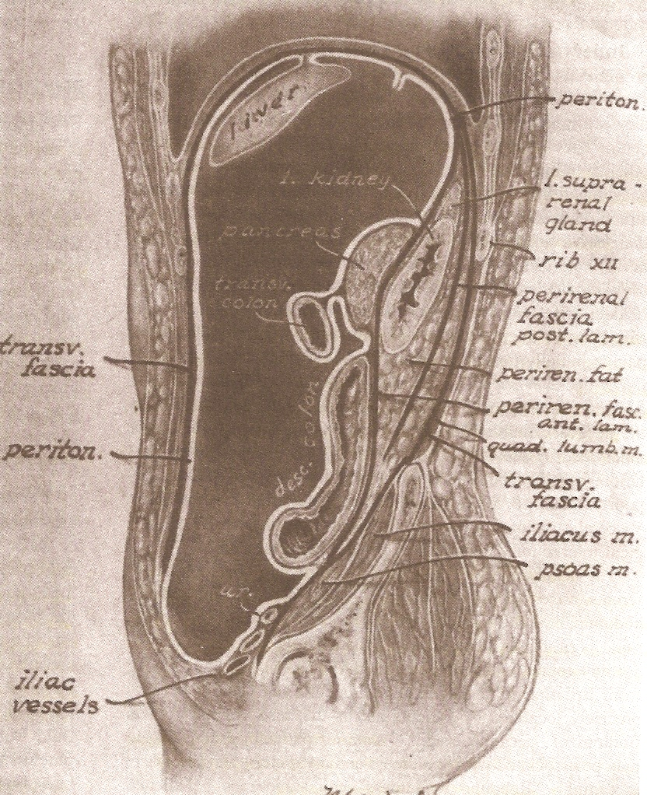
Gross:
Infra-mesocolic spaces:
Right lateral paracolic / right medial paracolic gutter
Left medial paracolic / left lateral paracolic gutter

Slide 14
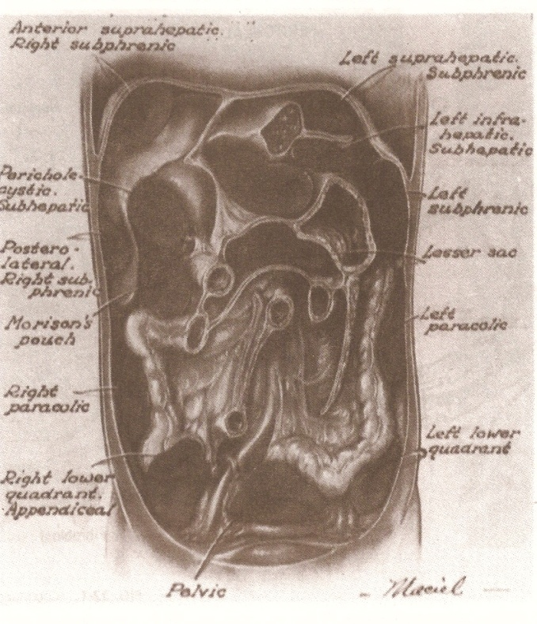
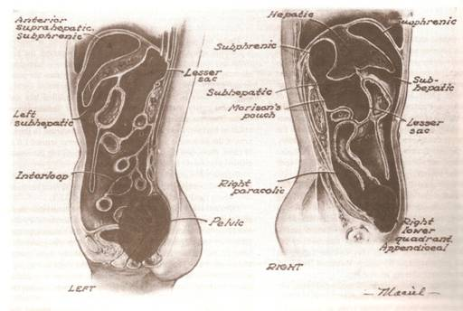
Gross:
Supra-mesocolic spaces: falciform lig.
Right sub-phrenic space: suprahepatic space / infrahepatic space
Left subphrenic space: - space bet. left lobe of liver & stomach
- lesser sac

Slide 15
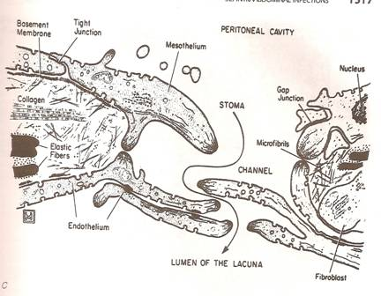
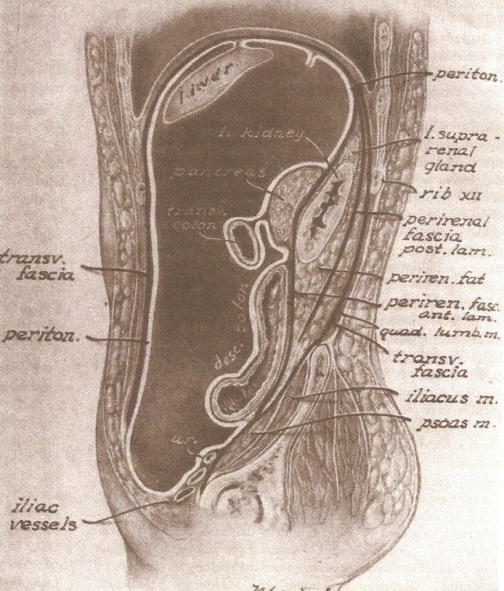
ANATOMY:
Microscopic:
Mesothelium – 1.8 m2
Mesothelial cells (cuboidal cells/flattened cells)
Stomata
Basement membrane
Connective tissue (collagen, elastic fiber, fibroblast, adipose, endothelial cells, mass cells, machrophage).
Gross:
Intra-abdominal area: (intraperitoneal / retroperitoneal)
Intra-peritoneal Space – defined by mesothelial membrane
a. visceral peritoneum
b. parietal peritoneum

Slide 16
PHYSIOLOGY
Peritoneal fluids:
Mesothelial lining cells; 50-100ml; identical to plasma
Fluid absorbed by mesothelial lining cells and sub-diaphragmatic lymphatics
Fluid exchange is affected by splanchnic bld flow & factors that alter permeability (intra-peritoneal inflam.)
Peritoneal fluid flow:
Forces that governs movement of fluids
Gravity: Fowler position ----> pelvic flow (abscess)
Negative pressure created beneath the diaphragm:
Intra-abd. pressure is lowest beneath the diaphragm during expiration
Supine: supramesocolic / interloop abscesses

Slide 17
PHYSIOLOGY
Peritoneal defense mechanism:
Peritoneal injury:
Inflammation ---> loss mesothelial cells ---> ‘metastasis’ of nearby mesothelial cells (3-5 days) repair without adhesion
Adhesion formation:
Forms when platelets and fibrin come in contact w/ exposed basement membrane --> hypoxia --> fibroblast invades the area --> stimulation of angiogenesis and collagen synthesis --> fully developed 10 days and maximal 2-3 wks

Slide 18
PHYSIOLOGY
Peritoneal defense mechanism:
Peritoneal defense against intra-abdominal infection:
Mechanical clearance of bacteria via lymphatics
Cleared through the stomata
Phagocytic killing of bacteria by immune cells. These cells from mediators subs. responsible for local & systemic response of our body to intra-abd. infections
Major cell types:
Macrophages
Mesothelial cells
Capillary endothelial cells
Recruited neutrophil

Slide 19
Classification of Intra-abdominal Infections: A ) PEITONITIS
Primary peritonitis:
Inflammation of the peritoneum from a suspected extraperitoneal source, often via hematogenous spread
Spontaneous peritonitis in children/adult:
Adult > children - mono-microbial infection
S/Sx: Abd. Pain, tenderness, distension, N/V, fever, lethargy, diarrhea in neonates

Slide 20
Classification of Intra-abdominal Infections:
Primary peritonitis:
Spontaneous peritonitis in children/adult:
ADULT:
Common in pts w/ ascites (cirrhosis, SLE)
E. coli (70%)
CHILDREN:
Neonatal / age 4-5
(+) Hx of previous URTI
W/ nephrotic syndrome, SLE
Hemolytic strp and pneumococci
Diagnostic: PARACENTESIS
Gm stain: Gm (+) spon. Peri.; GM (+) & (-) Sec. Peri
pH – Low; Neutrophil count - > 250 cells/mm3

Slide 21
Classification of Intra-abdominal Infections:
Peritonitis Related to Peritoneal Dialysis
Catheter related infection
Single organism: gm (+) cocci – 75%
- S. aureus / S. epidermidis
S/Sx: - turbidity of the dialysate (earliest sign)
- abdominal pain and fever
Dx: a) culture of peritoneal fluid
b) clinical signs of peritonitis
Tx: Initially ---> antibiotic & heparin in the dialysate
& increase the dwelling time
Removal of catheter:
persistence of peritonitis after 4-5 days of Tx
presence of fungal, tuberculosis, P. aeruginosa
fecal peritonitis
severe skin infection at the catheter site

Slide 22
Classification of Intra-abdominal Infections:
Tuberculous Peritonitis:
Common in developing and underdeveloped countries
Developed countries ---> due to AIDS
Route: a) Hematogenous
b) transmurally from diseased bowel
c) Tuberculous salphingitis
S/Sx: - fever, anorexia, wt. loss, weakness
- ascites, dull diffuse abd. pain, abd. Mass
Dx: a) Peritoneal fluid tap
- increase lymphocytes
- culture
b) Laparoscopy & direct biopsy
c) Percutaneous needle biopsy
Tx: - Anti Kochs drug for 2 yrs
- surgery done only in the presence of
COMPLICATIONS - Obstruction due to fibrous
adhesions

Slide 23
Secondary Peritonitis
Usually due to perforation or rupture of intra -
abdominal hallow viscous organs
Gastrointestinal Tract Perforation:
Perforation of Stomach/Duodenum: (Perforated peptic ulcer)
Initially cause chemical peritonitis ---> infected
Small Bowel Perforation:
Due to bowel obstruction
Intraluminal, transmural or extra-intestinal causes
obstruction ----> s/sx of peritonitis.

Slide 24
Gastrointestinal Tract Perforation:
Small Bowel Perforation:
Bowel wall necrosis:
Inflammation (Typhoid perforation)
S. typhi, penetrates Payer’s patches of terminal ileal wall.
Ischemia (Superior Mesenteric Occlusion)

Slide 25
Secondary Peritonitis
Gastrointestinal Tract Perforation:
Large Bowel Perforation:
Luminal bowel obstruction - Tumor
External bowel obstruction
Incarcerated hernia
Intussuception
Volvulus
Inflammation
Diverticulitis
Amebic peritonitis
Liver abscess / perforation of large bowel

Slide 26
Bacteriology of Intra-abdominal Infection
Normal bowel flora:
Level of Gastrointestinal Perforation:
Morbidity & mortality varies from level of GIT perforation
Proximal bowel – 10⁴⁻⁵/mm3; gm (-) aerobic bac.
Terminal ileum -10 ⁷⁻⁸/mm3
Colon -10¹⁰⁻¹²/mm3 gm (-) aerobic &
anaerobic
Virulence:
Impairs opsonization or phagocytosis & abscess formation. -------> B. fragilis (polysaccharide capsule)

Slide 27
Bacteriology of Intra-abdominal Infection
Microbial adherence to peritoneum:
Bacteria adherent to the peritoneum are resistant to removal by peritoneal lavage, in contrast to bacteria in peritoneal fluid.
1st 4hrs ----> aerobic E. coli, etc
8hrs. -------> B. fragilis
Microbial synergy:
Aerobic gm(-)bacteria – lowers oxidation – reduction potential; endotoxin produced suppress local host defense
B. fragilis – capsular polysaccharide interferes complement activation and inhibit leukocyte function

Slide 28
Bacteriology of Intra-abdominal Infection
Host effects on bacterial growth:
Host neurohumoral response to infection may enhance bacterial growth (NE, Cortisol)
Adjuvant substances:
Adjuvants increases bacterial virulence or interferes with host defenses
Adjuvants:
Blood (hgb, fibrin, platelet)
Bile salt
Urine
Pancreatic secretions
Gastric mucin
Chyle

Slide 29
Bacteriology of Intra-abdominal Infection
Foreign bodies:
Macroscopic:
Surgical drains
Suture
Laparotomy sponges
Hemostatic pads and powder
Surgical clips
Microscopic:
Barium sulfate
Clothing gibers, fecal material
Necrotic tissue
Talcum powder

Slide 30
Secondary Peritonitis
Peritonitis of genito-urinary origin:
Ruptured perinephric abscess
Ruptured chronic cystitis due to radiation therapy
Pelvic Inflammatory Diseases.

Slide 31
Secondary Peritonitis
Post-operative peritonitis:
Anastomotic leak: - s/sx appears 5 – 7 post-op day
Blind loop leak.

Slide 32
Secondary Peritonitis
Post traumatic peritonitis:
Peritonitis after blunt abdominal trauma
Unrecognized intra-abdominal injury, masked by other injuries
Peritonitis after penetrating abdominal injury

Slide 33
Tertiary peritonitis
Peritonitis without evidence for pathogen or with low grade pathogenic bacteria
State when host defense system produce a Syndrome of continued systemic inflammation

Slide 34
Other Form of Peritonitis
Asepic / sterile peritonitis Ex. Chemical → peptic ulcer
Drug-related peritonitis: isoniazid and erythromycin estolate
Periodic peritonitis: familial dse (Jews, Arabs, Armenians) Tx: cochicine
Lead peritonits
Hyperlipemic peritonits
Porphyrin peritonitis
Talc peritonitis (hypersensitivity response)
Foreign body peritonits

Slide 35
Localized peritonitis
Factors that favors the localization of peritonitis:
1-Anatomical.
2-Pathological:Inflamed peritoneum
loses its glistening appearance and becomes reddened and velvety. Flakes of fibrin appear and cause loops of intestine to become adherent to one another and to the parietes.
There is an outpouring of serous inflammatory exudate rich in leukocytes and plasma proteins that soon becomes turbid; if localisation occurs, the turbid fluid becomes frank pus. Peristalsis is retarded in affected bowel and this helps to prevent distribution of the infection. The greater omentum, by enveloping and becoming adherent to inflamed structures, often forms a substantial barrier to the spread of infection

Slide 36
Diffuse (generalised) peritonitis
factors that may favor the development of diffuse peritonitis:
1- Speed of peritoneal contamination.
2-Stimulation of peristalsis by the ingestion of food or even water hinders localisation.
3-The virulence of the infecting organism.
4- age : Young children have a small omentum, which is less effective in localising infection.
5- handling, e.g. appendix mass or pericolic abscess.
6- Deficient natural resistance (‘immune deficiency’)

Slide 37
Localized peritonitis
Anatomical and pathological factors may favour the localisation of peritonitis:
A)Anatomical
The greater sac of the peritoneum is divided into (1) the subphrenic spaces, (2) the pelvis and (3) the peritoneal cavity proper. The last is divided into a supracolic and an infracolic compartment by the transverse colon and transverse mesocolon, which deters the spread of infection from one to the other.

Slide 38
B) pathological factors may favor the development of diffuse peritonitis:
1) Speed of peritoneal contamination is a prime factor. If an inflamed appendix or other hollow viscus perforates before localisation has taken place, there will be an efflux of contents into the peritoneal cavity, which may spread over a large area almost instantaneously.
2)Stimulation of peristalsis by the ingestion of food or even water hinders localisation

Slide 39
3) The virulence of the infecting organism may be so great as to render the localization of infection difficult or impossible.
4) Young children have a small omentum, which is less effective in localizing infection.
5) Disruption of localized collections may occur with injudicious handling, e.g. appendix mass or pericolic abscess.
6)Deficient natural resistance (‘immune deficiency’) may result from use of drugs (e.g. steroids), disease (e.g. acquired immune deficiency syndrome (AIDS)) or old age.

Slide 40
Diagnosis of Intra-abdominal infection
Clinical History:
Abdominal Pain: - location (changes)/ character (changes)/intensity
Visceral pain – due to distention or traction of hallow viscus
- dull, poorly localized, crampy
Somatic pain – well localized, pain sensitive to stretch, light touch and cutting
- associated w/ tenderness and involuntary muscle spasm
Dual mechanism of pain:
The pathognomonic signs are localized guarding (involuntary abdominal wall contraction to protect the viscus from the examining hand), a positive ‘release’ sign (rebound tenderness) and, sometimes, rigidity (involuntary constant contraction of the abdominal wall over the inflamed parietes).
If inflammation arises under the diaphragm, shoulder tip (‘phrenic’) pain may be felt as the pain is referred to the C5 dermatome.
Length of time pt is ill
Chills and fever, anorexia, N/V, ileus

Slide 41
In cases of pelvic peritonitis arising from an inflamed appendix in the pelvic position or from salpingitis, the abdominal signs are often slight; there may be deep tenderness of one or both lower quadrants alone, but a rectal or vaginal examination reveals marked tenderness of the pelvic peritoneum.

Slide 43
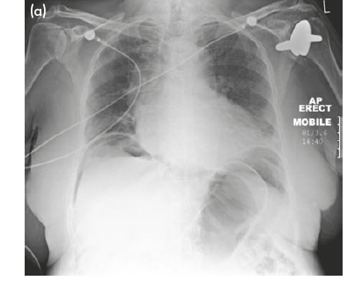
Diagnosis of Intra-abdominal infection
Laboratory test:
CBC / Differential count
Serum electrolyte/creatinine/liver profile/amylase
Radiological techniques:
FPA : a) pneumoperitoneum
b) intestinal pneumatosis
c) bowel obstruction
d) widening of the space between
loops
e) mass effect – indicative of abscess
f) obliterated psoas shadow
Use of contrast material (barium, water soluble)
If suspecting for abscess:
Ultrasonography and CT scan - diagnostic and therapeutic

Slide 44
Management
1) Correction of fluid loss and circulating volume. The plasma volume must be restored and electrolyte concentrations corrected. Fluid balance should be monitored and pre-existent and ongoing losses corrected.
2) Urinary catheterization ± gastrointestinal decompression.
3) Antibiotic therapy: Administration of parenteral broad-spectrum (aerobic and anaerobic) antibiotics prevents the multiplication of bacteria and the release of endotoxins.
4) Analgesia: The patient should be nursed in the sitting-up position and must be relieved of pain before and after operation

Slide 45
Specific treatment of the cause
Depending on the underlying causes , in the majority of cases ; early surgical intervention is to be preferred to a ‘wait and see’ policy assuming that the patient is fit for anesthesia and that resuscitation has resulted in a satisfactory restitution of normal body physiology .
usually within a few hours.

Slide 46
Surgery is directed to removing (or diverting) the cause and subsequent adequate peritoneal lavage ± drainage. In operations for generalised peritonitis it is essential that, after the cause has been dealt with, the whole peritoneal cavity is explored with the sucker and, if necessary, mopped dry until all seropurulent exudate is removed. The use of a large volume of saline (typically 3 litres) containing dissolved antiseptic or antibiotic has been shown to be effective.

Slide 47
Prognosis and complications
With modern treatment, diffuse peritonitis carries a mortality rate of about 10 per cent reflecting the degree and duration of peritoneal contamination, age and fitness of the patient and the nature of the underlying cause.
With appropriate treatment, localised peritonitis usually resolves; in about 20 per cent of cases, an abscess follows.
Infrequently, localised peritonitis becomes diffuse. Conversely, in favourable circumstances, diffuse peritonitis can become localised, most frequently in the pelvis or at multiple sites within the abdominal cavity.

Slide 48
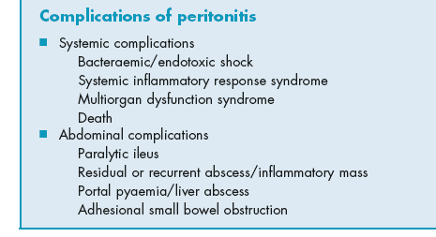

Slide 49
Intra-abdominal Abscess
Accumulation of pus in intra-peritoneal spaces
Associated w/ primary peritonitis
Associated w/ secondary peritonitis

Slide 50
HOW CAN WE SUSPECT?
Symptoms
Malaise, lethargy – failure to recover from surgery as expected
Anorexia and weight loss
Sweats ± rigors
Abdominal/pelvic pain
Symptoms from local irritation, e.g. shoulder tip/hiccoughs
(subphrenic), diarrhoea and mucus (pelvic), nausea and
vomiting (any upper abdominal)
Signs
Increased temperature and pulse ± swinging pyrexia
Localised abdominal tenderness ± mass (including on pelvic
exam)

Slide 51
Management of Intra-abdominal Infection
Left subphrenic abscess:
Most common variety of upper abd. abscess after peritonitis or leakage from a viscus
Splenectomy / pancreatitis
S/Sx: - costal tenderness of the left
(+) Kehr’s sign
(+) left pleural effusion
- limitation of diaphragmatic motion
Tx: - drained posteriorly through the bed of the12th rib
- extraperitoneal approach (lateral extraserous route)

Slide 52
Lesser Sac Abscess:
(L) subhepatic / subphrenic abscess
Complication of dse of stomach, duodenum and pancreas
Most common cause is pancreatic abscess
Sx: Midepigastric tenderness ----> ultrasound /
CT scan
Tx: - Approach directly at upper abd. Incision
- Drain are placed at dependent area
- Sump – suction drains

Slide 53
Management of Intra-abdominal Infection
Right subphrenic abscess:
Secondary to rupture of hepatic abscess & post-operative complication of gastric or duodenal surgery
S/Sx: - Pain upper abd. (Kerh sign) / lower chest
- Limitation of ® diaphragmatic motion
- air fluid level
Right sub-hepatic Abscess (Morrison’s Pouch)
Due to:
Gastric procedure (most common)
Biliary surgery
Appendicitis
Colonic surgery
Right upper quadrant pain and tenderness
Ultrasound / Ct scan

Slide 54
Management of Intra-abdominal Infection
Interloop Abscesses:
Multiple abscesses / loculation between loops of bowel, mesentery, abd wall & omentum
Rarely involved the upper abd
Involves the pelvis (gravity)
No reliable S/Sx: has preceding signs of peritonitis w/ incomplete resolution
CT scan ---> most reliable diagnostic tool
Tx: trans-peritoneal exploration

Slide 55
Management of Intra-abdominal Infection
Pelvic Abscesses:
Due to: - ruptured colonic diverticulitis
- PID
- Ruptured appendicitis
Drainage into the pelvis during resolution of generalized peritonitis
Sx: - poorly localized dull lower abd. pain
- irritation of bladder (urgency/requency) rectum (diarrhea/tenesmus)
Dx: - Ultrasound / Ct scan
- tender mass on rectal/vaginal exam
Tx: - Pelvic drainage (rectum/vagina)
- drainage shd. be delayed until formation of the
pyogenic membrane that excluded the space

Slide 56
Retroperitoneal Abscess:
Due to:
Pancreatitis
Primary or secondary infection of the kidney/ureter/colon
Osteomyelitis of the spine
Trauma
Sx: fever / tenderness over the involved site
Dx: CT scan
Tx: - Extra-peritoneal approach
- Percutaneous catheter by CT scan/ultrasound

Slide 57
Management of Intra-abdominal abscess
DO NOT LET THE SUN RISES ON UNDRAINED ABSCESS.
The same lines of management .
If source is controlled w/ early surgical intervention, peritonitis responds to vigorous antibiotics & supportive therapy.
Failure to solved ---> continuous peritoneal soiling ----> death

Slide 58
A) Percutaneous drainage
Is usually successful if the following criterias are met:
Unilocular fluid collection
A safe percutaneous route of access is available
Joined evaluation by surgeon & radiologist
With immediate operative backup available

Slide 59
B) Operative management of intra-abdominal abscess:
Failure of percutaneous drainage
Inability to safely drain percutaneously
Presence of pancreatic or carcinomatosis abscess
Associated w/ a high output bowel fistula
Involvement of lesser sac
Multiple isolated inter-loop abscesses
Abscess suspected clinically but cannot be localized by CT / ultrasonography

Slide 60
Catheter placed are removed when the criteria for abscess resolution are met:
Resolution of symptoms and indicators of infection (leucocytosis)
Decrease in daily drainge, less than 10 ml & change in the character of the drainage from purulent to serous
Radiology verify abscess resolution and closure of communication

Slide 61
Factors that cause Percutaneous Aspiration Drainage failure:
Fluid that is too viscous for drainage or the presence of phlegmon or necrotic debris
Multiloculated collection & multiple abscesses
Fistulous communication, as in drainage of necrotic tumor mistake for an abscess
Immunocompromised patients

Slide 62
ASCITES
Ascites is defined as an accumulation of excess serous fluid within the peritoneal cavity.
Pathophysiology
The balanced effects of plasma and peritoneal colloid osmotic and hydrostatic pressures determine the exchange of fluid between the capillaries and the peritoneal fluid.
Protein-rich fluid enters the peritoneal cavity when capillary permeability is increased, as in peritonitis and carcinomatosis peritonei.
Capillary pressure may be increased because of generalised water retention, cardiac failure, constrictive pericarditis or vena cava obstruction.
Capillary pressure is raised selectively in the portal venous system in the Budd–Chiari syndrome, cirrhosis of the liver or extrahepatic portal venous obstruction.
Plasma colloid osmotic pressure may be lowered in patients with reduced nutritional intake, diminished intestinal absorption

Slide 63
Clinical features
Ascites can usually only be recognised clinically when the amount of fluid present exceeds 1.5 L depending on body habitus:
in the obese a greater quantity than this is necessary before there is clear evidence.
The abdomen is distended evenly usually, shifting dullness is present but when there is a very large accumulation of fluid this sign is absent. In such cases.
on flicking the abdominal wall, a characteristic fluid thrill is transmitted from one side to the other

Slide 64
Investigation
liver and cardiac function tests, ultrasound
and/or CT imaging will determine much smaller quantities of ascites than possible clinically.
Ascitic aspiration is now most commonly performed under imaging guidance to minimize the risk of visceral injury.
Fluid is sent for microscopy/cytology, culture, including mycobacteria, and analysis of protein content and amylase

Slide 65
Treatment
of the specific cause is undertaken whenever possible . In rare cases in which ascites accumulates rapidly after paracentesis and the patient is otherwise fit, permanent drainage of the ascitic fluid via a peritoneovenous shunt.

Slide 66
Chylous ascites
In some patients the ascitic fluid appears milky because of an excess of chylomicrons (triglycerides). Most cases are associated with malignancy, usually lymphomas; other causes are cirrhosis, tuberculosis, filariasis, nephrotic syndrome, abdominal trauma (including surgery), constrictive pericarditis, sarcoidosis and congenital lymphatic abnormality. The prognosis is poor unless the underlying condition can be cured. In addition to other measures used to treat ascites, patients should be placed on a fat free diet with medium-chain triglyceride supplements.

Slide 67
TUMOURS OF THE PERITONEUM
Primary tumours of the peritoneum are rare.
Secondary tumours (Carcinomatosis peritonei)
This is a common terminal event in many cases of carcinoma of the stomach, colon, ovary or other abdominal organs and also of the breast and bronchus.
Pseudomyxoma peritonei : This rare condition occurs more frequently in women. The abdomen is filled with a yellow jelly, large quantities of which are often encysted. The condition is associated with mucinous cystic tumours of the ovary and appendix. Recent studies suggest that most cases arise from a primary appendiceal tumour with secondary implantation on to one or both ovaries

Slide 68
ADHESIONS
Pathophysiology
Adhesions are strands of fibrous tissue that form, usually as a result of surgery, between surgically injured tissues. After injury, there is bleeding and an increase in vascular permeability with extravasation of fibrinogen-rich fluid from the injured surfaces forming a temporary fibrin matrix. An inflammatory response ensues with cell migration, release of cytokines, and activation of the coagulation cascade. The activation of the coagulation system results in thrombin formation, which is necessary for the conversion of fibrinogen to fibrin. In the absence of fibrinolysis, adhesions will form within 5–7 days as the matrix gradually becomes more organized with collagen secretion by fibroblasts.

Slide 69
Complications
Adhesive small bowel obstruction (SBO)
secondary infertility.
chronic abdominal and pelvic pain.

Slide 70
Prevention
NO method can prevents adhesion , but we can minimize it by :
Minimising the production of ischaemic tissue by careful operative technique, including meticulous control of bleeding
Laparoscopy.
drugs including anti-inflammatory drugs like aspirin and steroids, some hormones , anticlotting agents, antibiotics, vitamin E and even methylene blue
4% icodextrin solution) is a solution applied inside the abdomen at the time of surgery.
(oxidised regenerated cellulose) which quickly forms a soft gelatinous mass around healing tissues and is absorbed within 2 weeks. It has been shown to significantly reduce the number of adhesions at the site where it is used.

